Slide 1
Daniil
Sabina
Zaur
Ali
NETWORKING

Slide 2
IP ADDRESSES
An IP address is a unique address that identifies a device on the internet or a local network. IP stands for "Internet Protocol," which is the set of rules governing the format of data sent via the internet or local network.
The internet needs a way to differentiate between different computers, routers, and websites. IP addresses provide a way of doing so and form an essential part of how the internet works.
IP addresses are expressed as a set of four numbers — an example address might be 192.158.1.38. Each number in the set can range from 0 to 255. So, the full IP addressing range goes from 0.0.0.0 to 255.255.255.255.
IP addresses are not random. They are mathematically produced and allocated by the Internet Assigned Numbers Authority (IANA)
All devices find, send, and exchange information with other connected devices using this protocol. By speaking the same language, any computer in any location can talk to one another.

Slide 3
PROTOCOLS
IPv4 and IPv6 are internet protocol version 4 and internet protocol version 6, IP version 6 is the new version of Internet Protocol, which is way better than IP version 4 in terms of complexity and efficiency.
1
IPV4
2
IPV6

Slide 4
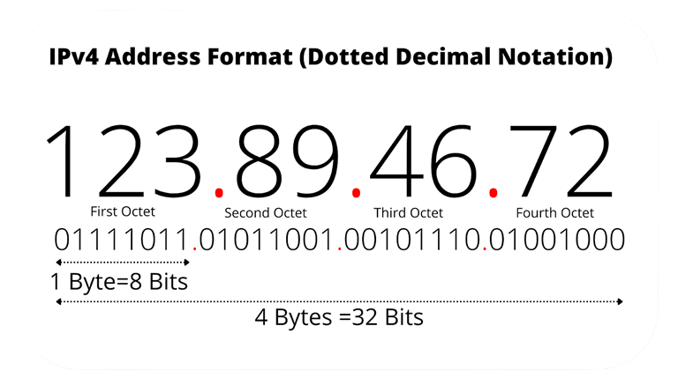
WHAT IS IPV4?
IPv4 stands for Internet Protocol version 4. It is the underlying technology that makes it possible for us to connect our devices to the web. Whenever a device accesses the Internet, it is assigned a unique, numerical IP address such as 99.48.227.227. To send data from one computer to another through the web, a data packet must be transferred across the network containing the IP addresses of both devices.

Slide 5
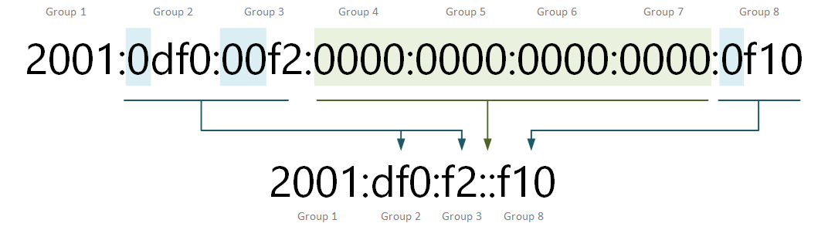
WHAT IS IPV6?
IPv6 is the next generation Internet Protocol (IP) address standard intended to supplement and eventually replace IPv4, the protocol many Internet services still use today. Every computer, mobile phone, home automation component, IoT sensor and any other device connected to the Internet needs a numerical IP address to communicate between other devices. The original IP address scheme, called IPv4, is running out of addresses due to its widespread usage from the proliferation of so many connected devices.

Slide 6
IPV4
IPV6
IPv4 has a 32-bit address length
IPv6 has a 128-bit address length
It Supports Manual and DHCP address configuration
It supports Auto and renumbering address configuration
In IPv4 end to end, connection integrity is Unachievable
In IPv6 end-to-end, connection integrity is Achievable
It can generate 4.29×109 address space
Address space of IPv6 can produce 3.4×1038 address space
The Security feature is dependent on application
IPSEC is an inbuilt security feature in the IPv6 protocol

Slide 7

What is Subnet Mask?
A subnet mask is a 32-bit number created by setting host bits to all 0s and setting network bits to all 1s. In this way, the subnet mask separates the IP address into the network and host addresses.
The “255” address is always assigned to a broadcast address, and the “0” address is always assigned to a network address. Neither can be assigned to hosts, as they are reserved for these special purposes.The IP address, subnet mask and gateway or router comprise an underlying structure—the Internet Protocol—that most networks use to facilitate inter-device communication. When organizations need additional subnetworking, subnetting divides the host element of the IP address further into a subnet. The goal of subnet masks are simply to enable the subnetting process. The phrase “mask” is applied because the subnet mask essentially uses its own 32-bit number to mask the IP address.

Slide 8
IP Address and Subnet Mask
A 32-bit IP address uniquely identifies a single device on an IP network. The 32 binary bits are divided into the host and network sections by the subnet mask but they are also broken into four 8-bit octets.
Because binary is challenging, we convert each octet so they are expressed in dot decimal. This results in the characteristic dotted decimal format for IP addresses—for example, 172.16.254.1. The range of values in decimal is 0 to 255 because that represents 00000000 to 11111111 in binary.

